Slide 1
Public Health 101 Faculty YTJ Section-28
Presentation

Slide 2

Group-C Sujon Majumdar Azizul Tareq Farzana Urmi Mahi Zebin Al Mahmud Z. M. Zulkarnine

Slide 3

Tuberculosis
a deadly yet curable disease

Slide 4
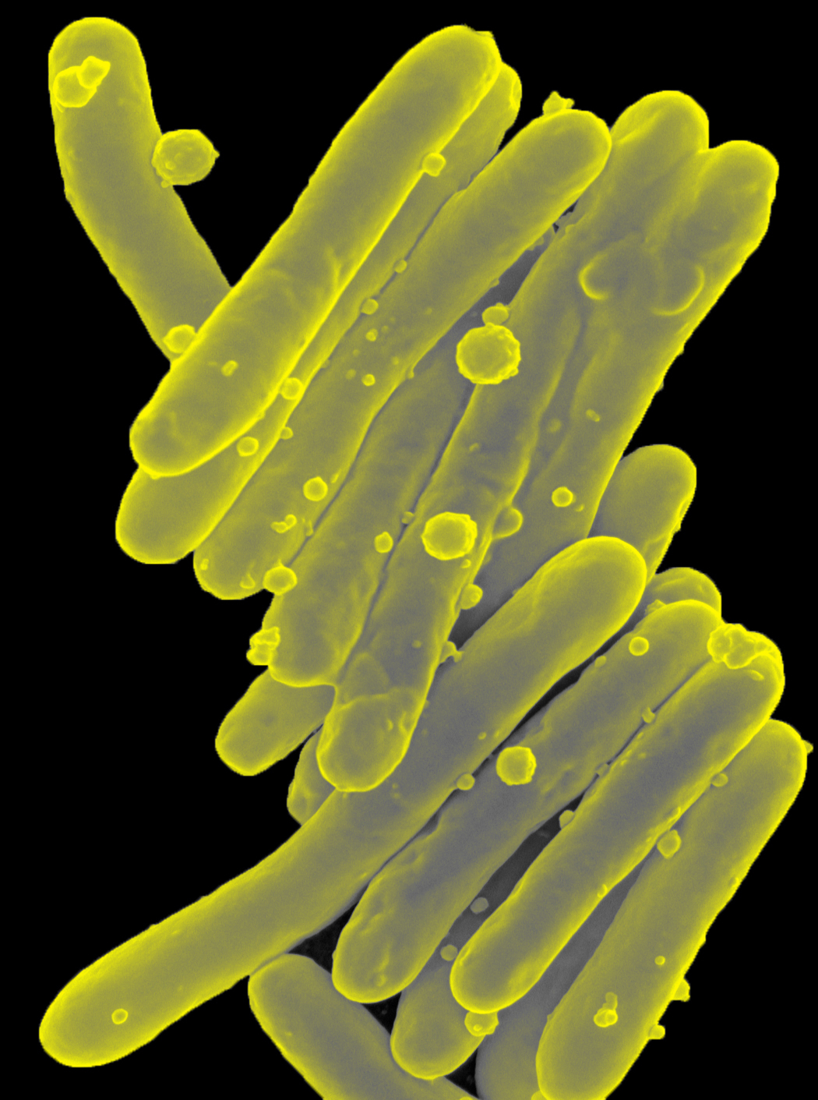
Introduction:- Tuberculosis or TB its commonly called, TB is a bacteria disease which in humans is usually caused by an organism called Mycobacterium tuberculosis. TB infection spread through inhaling tiny droplets from the coughs or sneezes of an infected person, the bacteria released into the air . Typically, its attacks the lungs and also other parts of the body like-kidney, spine, brains.
Microscopic image of a long, thin, rod-like bacteria. Colorized scanning electron micrograph of Mycobacterium tuberculosis.

Slide 5
Tuberculosis is the second biggest killer globally . In 2015 1.1 million people died cause of having TB.

Slide 6
Types of tb
there are two types of tb infection
1.latent & 2.active
Latent :-
in latent, the bacterium that causes tb, remains in the body in an
inactive state. They cause no symptoms and are contagious. Further,
they can become active.
Active :-
In some people, tb bacteria destroys the immune systems defenses
and begin to multiply, resulting in the progression from latent tb
infection to tb diseases.

Slide 7
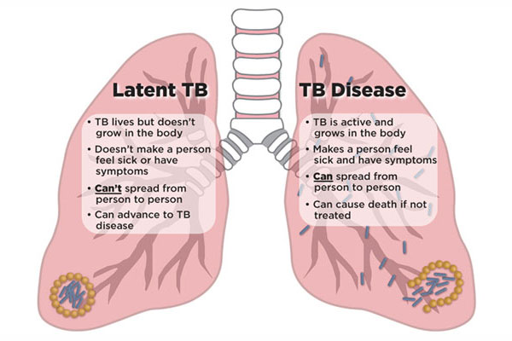

Slide 8



SYMPTOMS
Coughing sometimes with mucus or blood
Chills
Fatigue

Slide 9

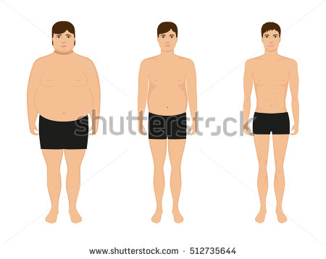


SYMPTOMS
Chest pain, or pain with breathing & coughing
Loss of weight
Lose of appetite
Night sweats

Slide 10


Hello! I’m a public health officer
Case briefing :
Hello!! I’m a public health officer
vaccination
HIV prevention
Breastfeeding tips
TB treatment and follow up

Slide 11
Treatment of TB
Treatment of TB takes six to nine months and sometimes longer. TB can be cured in almost all cases by taking the medication as prescribed by your doctor for the full course of treatment (At least six month)
Multi-drug treatment is employed to treat active TB disease. Depending on state or local public health regulations, you may be asked to take your antibiotics under the supervision of your physician or other healthcare professional. This program is called “Directly Observed Therapy”.
Designed to prevent abandonment or erratic treatment, which may result in “failure” with continued risk of transmission or acquired resistance of the bacteria to the medications, including the infamous multi-drug resistance TB (MDR-TB).

Slide 12
Most Common Drugs For TB
If you latent tuberculosis, you may need to take just one types of. Active tuberculosis, particularly if it’s a drug-resistant strain, will require several drugs at once.The most common medications used to treat tuberculosis include.
Isoniazid
Rifampin (Rifadin,Rimactane)
Ethambutol (Myambutol)
Pyrazinamide
A number of new drugs are being looked at as add-on therapy to the current drug-resistant combination treatment, including:
Bedaquiline
Linezolid

Slide 13
Completing treatment is essential
After a few weeks, you won’t be contagious and you may start to feel better. It might be tempting to stop taking your TB drugs. But it is crucial that you finish the full course of therapy and take the medication exactly as prescribed by your doctor.

Slide 14
IDENTIFIED PROBLEMS
conservative society
Male dominating society
Lack of knowledge
No social awareness
Stigma in the community
No education

Slide 15
PROPOSED SOLUTION
Increasing Literacy Rate
Social awareness
Reducing Male Dominance
Empowering and motivating all to take free TB service

Slide 16
Social Awareness
R
advertising on different media
Arranging seminar
Plays with morals
Woman education

Slide 17

ENCOURAGE SCHOOL-GOING
HOLD SEMINARS ON IMPORTANCE OF EDUCATION
DEPENDENCE OF HEALTH ON EDUCATION
Improving Literacy Rate

Slide 18
Family breakup
TB is fatal , affect is organ
Severe lung damage if not treated

Slide 19


ENCOURAGEMENT (to go to clinic)
CONSULTING WITH EXPERT DOCTORS
BRINGING CLINIC TO COMMUNITY(2 points)
MALE SHOULD ENCOURAGE FEMALE TO GO TO CLINIC
PRIORITY TREATMENT ON OTHER DISEASES

Slide 20
Male dominance
A male-dominated society is one that benefits men in laws, education, academia and day-to-day life
Reduction of male dominance
Clearing misconception on religion
Participation of woman in earning
Changing woman’s mentality
Move towards openmindedness

Slide 21
Current Situation in Bangladesh
r
The South-East Asia region accounts for a disproportionately high number of global TB cases and Bangladesh is one of 22 ‘high TB-burden’ countries.
WHO has set a target for a 95% reduction in deaths and a 90% reduction in TB incidence by 2035.
A treatment success rate of 93% has been achieved among all new and relapsed cases.
Bangladesh faces challenges in achieving universal access to TB prevention and care services because of poor access to good quality diagnostic services

Slide 22
TB report
r

